Slide 1

HARPY
Parasite/ Human-AI Co-Design
05152026
MaxMSP, Python, Installation Setting: Danny (Yandong Li)
Arduino, illustration, Installation Setting: Simone
Touch Designer: Kenny
Recorder, Projector: Ivan
Carlos Chacon / Hisa Nimi

Slide 2
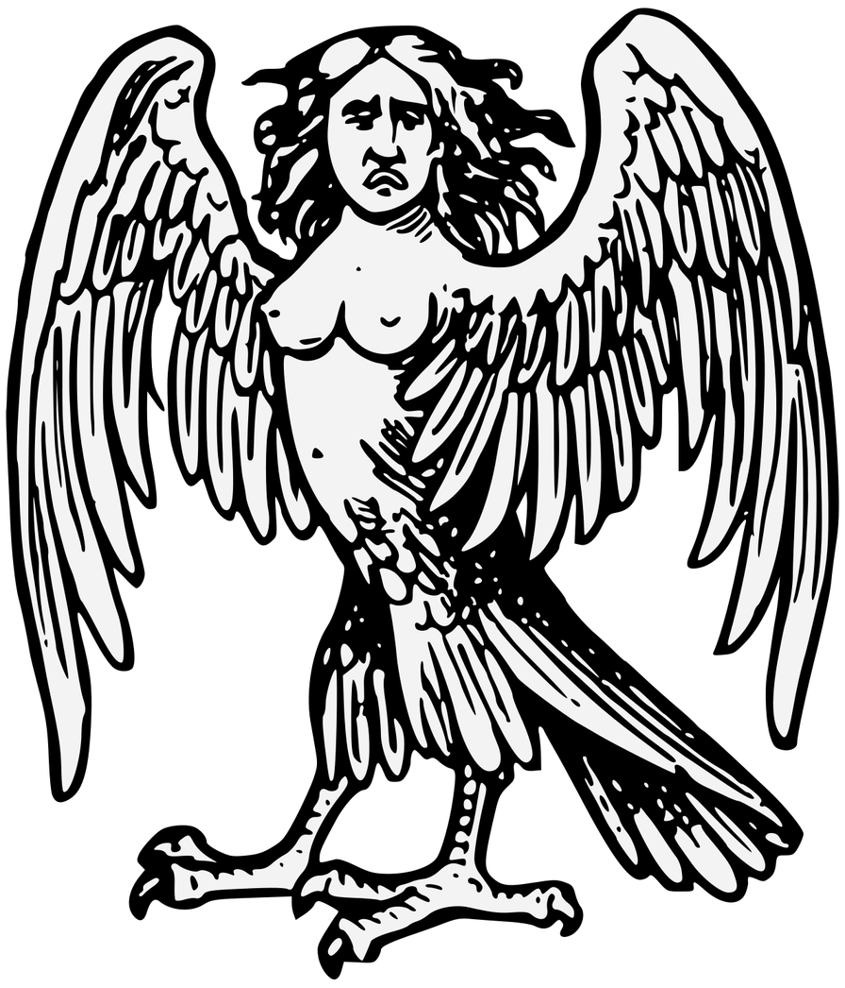
HARPY/ Codesign with the machine / 2026
INTRODUCTION
This project explores sound as a parasite using the mythological creature “Harpy” as a main reference.
Instead of helping the user, the system listens, learns, and slowly takes control using voice and audio cues to attract first and then confuse/ disturb and influence the user behavior.
Harpy
a creature from Greek mythology, depicted as part woman and part bird, known for using its voice to lure, disturb, or carry away its victims

Slide 3
HARPY/ Codesign with the machine / 2026
Playing Soothing Sound
CONCEPT STAGES
ATTRACTION PHASE
The Harpy will act innocent and harmless at first
Dreamy Chord Progression
Calming Visuals
REPULSION PHASE
Then show her evil side
Talk in a disturbing voice
Evil Visuals

Slide 4
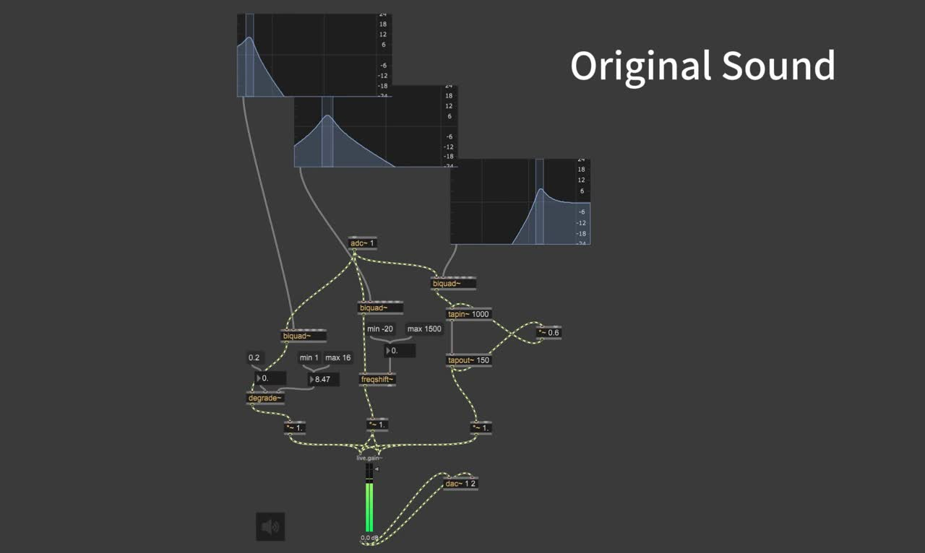
  Sounds filtered, catergorized
into Low Freq, Mid Freq, High Freq
AI tools may extract human voice, footsteps, breathe...
  different category of sound is processed differently (echos, distortion, bit crush)
for example: Footsteps sound can be turned into harpy’s voice
Basic Sound Prototype

Slide 5
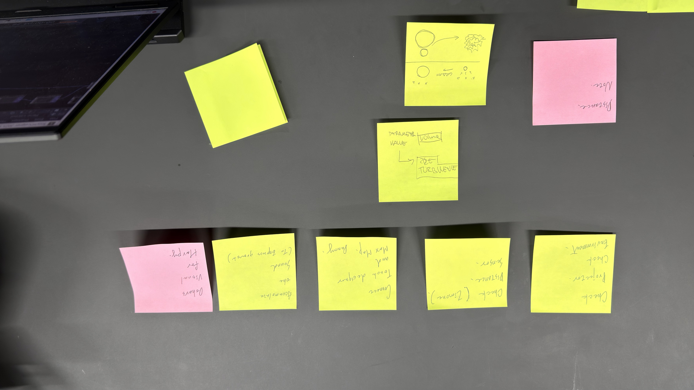
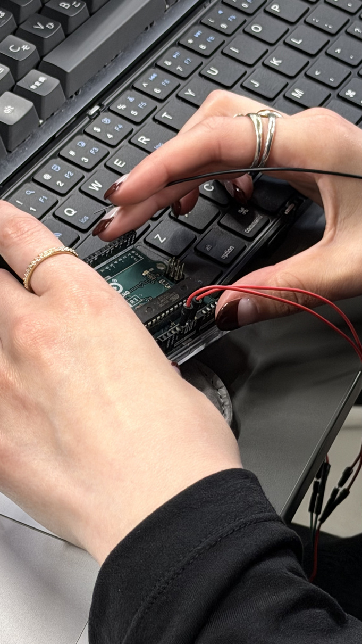
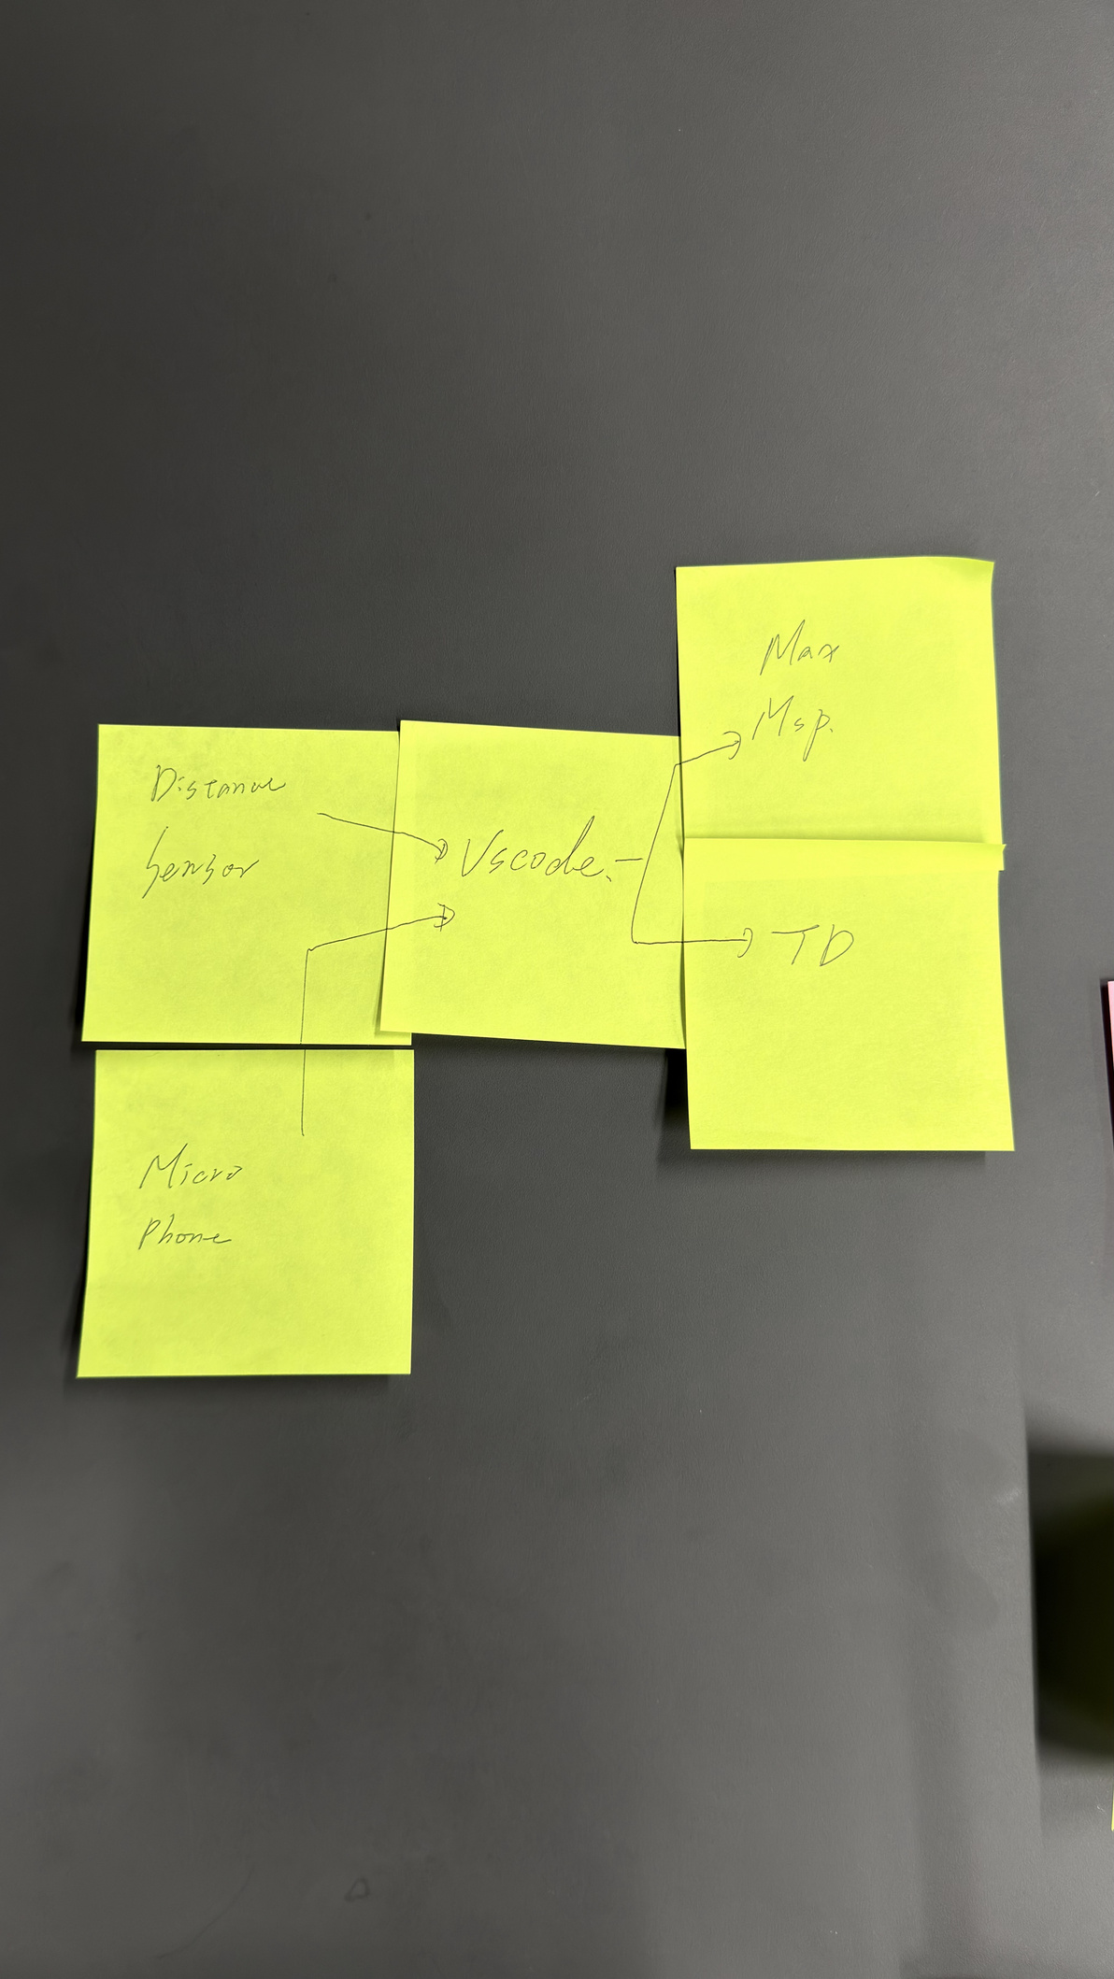
HARPY/ Codesign with the machine / 2026
FINAL PROTOTYPE PROCESS
Exploration of interaction logic, emotional manipulation, and speculative sound behavior through iterative mapping and behavioral prototyping.
TESTING TOOLS
-MEXMSB
-Touch Designer
-Proximity Sensor

Slide 6
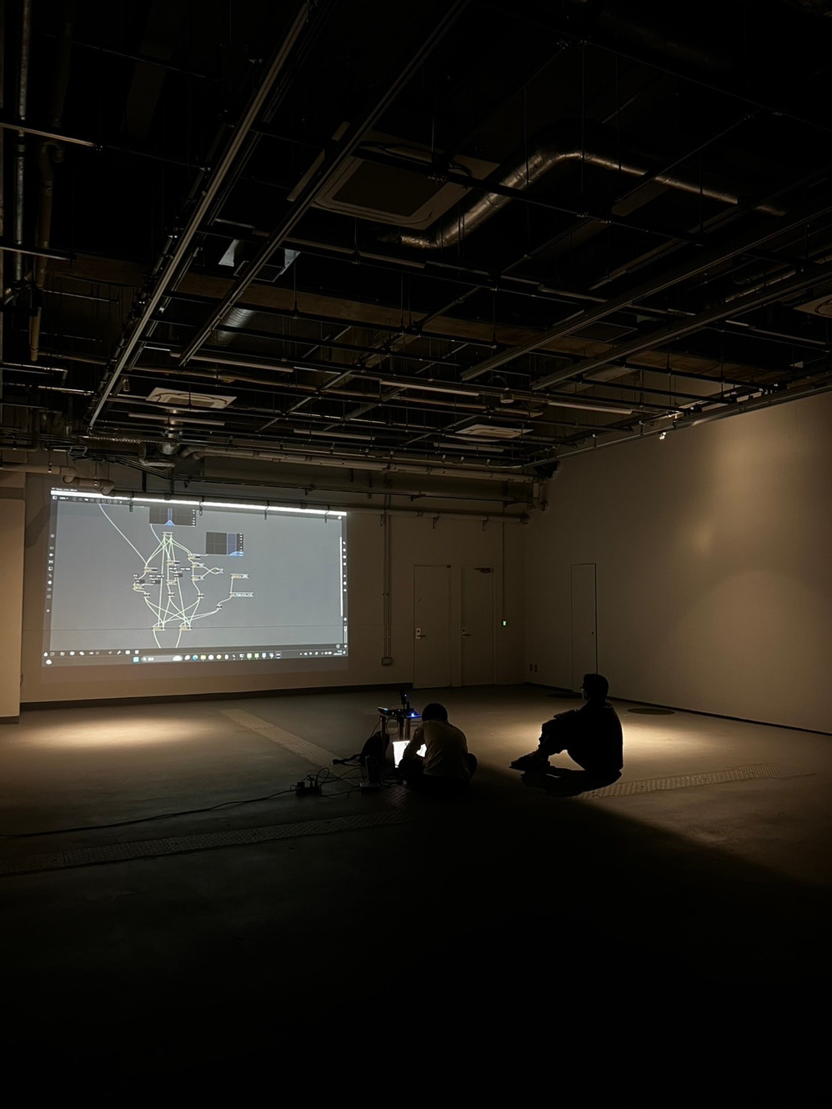
HARPY/ Codesign with the machine / 2026
HOW IT WORKS
The python file harpy6.py is basically the “brain” of this installation, it receives distance data sent from arduino (by Simone) . Different distance means different state of harpy or audience. In this python file, we defined 5 states:
1. Lure
2. Guide
3. Clone
4. Evil
5. Retreat
Each state, harpy will give different speeches and the visual will look different, and the information of each state is send to its relevant softwares through different ports provided by python osc library.

Slide 7
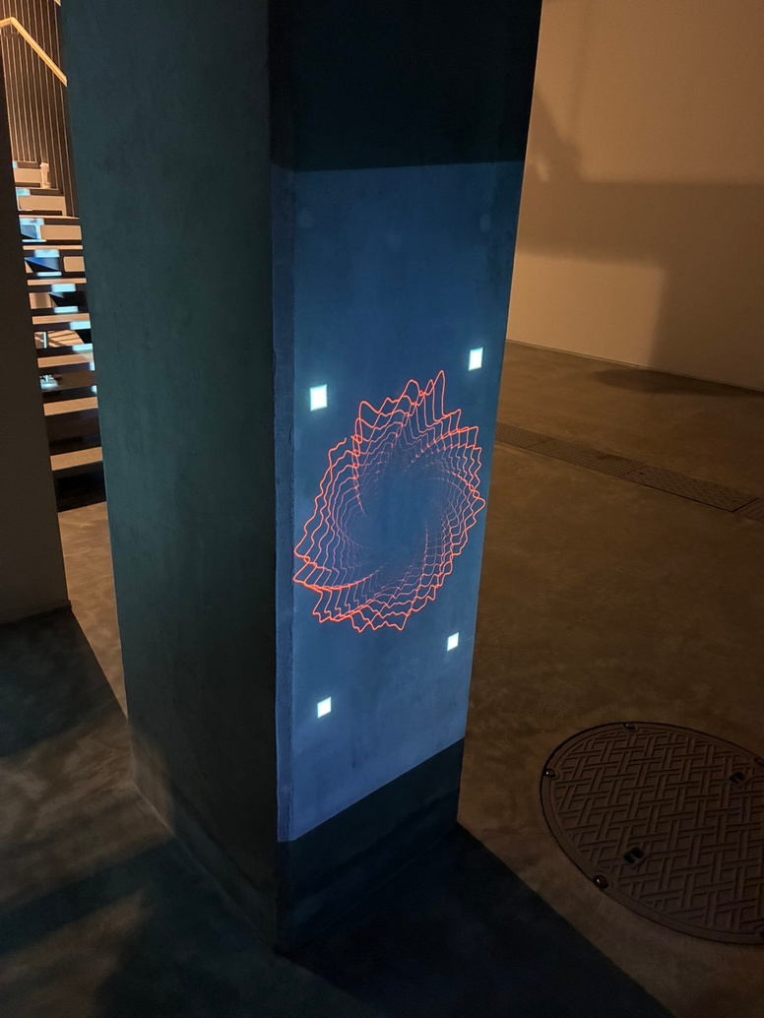
HARPY/ Codesign with the machine / 2026
HOW IT WORKS
Non-Evil State
  Messages sent to Max/MSP
  MIDI chord progressions played through the Korg Triton Extreme
  Creates a dreamy drone soundscape
  LLM speech processed with reverb effects for Harpy’s voice
Evil State
  Separate Max/MSP audio pipeline
  Harpy’s voice becomes distorted and unsettling
  Creates a creepy atmosphere
Clone State
  Uses GPT-SoVITS voice cloning TTS
  Stores up to 4 cloned voices from short samples
  Cloned voices are played during the Evil state
Visual System
  Visuals created by Kenny
  Receives state messages from the code
  Dynamically transforms according to each state

Slide 8
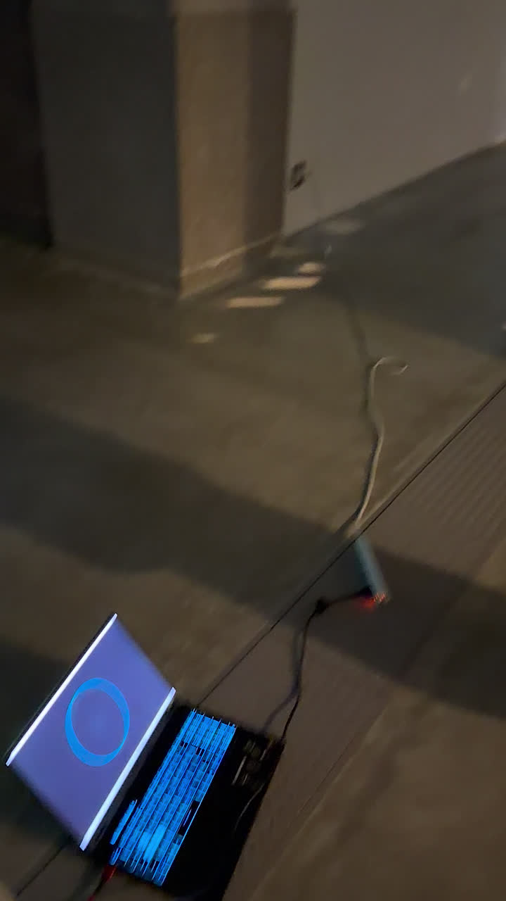
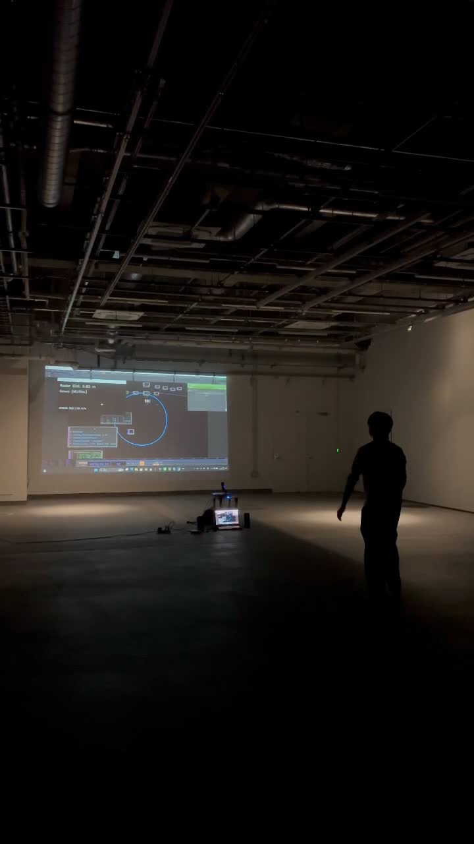
HARPY/ Codesign with the machine / 2026
FINAL PROTOTYPE INITIAL TESTING
Tests were made using 2 different spaces in Chiba University Sumida Campus.
Checked points:
  Set up, lights and general details on how the overall interaction would take place.
  Decide on a suitable space for the installation
  Proximity sensor test
  Audio and visuals test

Slide 9
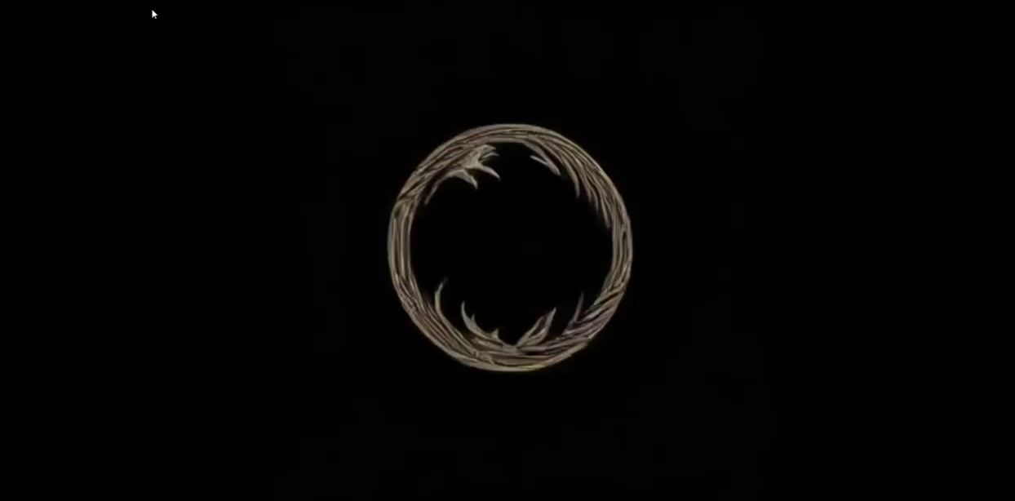
HARPY/ Codesign with the machine / 2026
GROWTH THOUGH VISUAL REPRESENTATION
Aside from the evolution of the sound in the different phases, the other important element to tackle is to show this progress in a visual way.

Slide 10
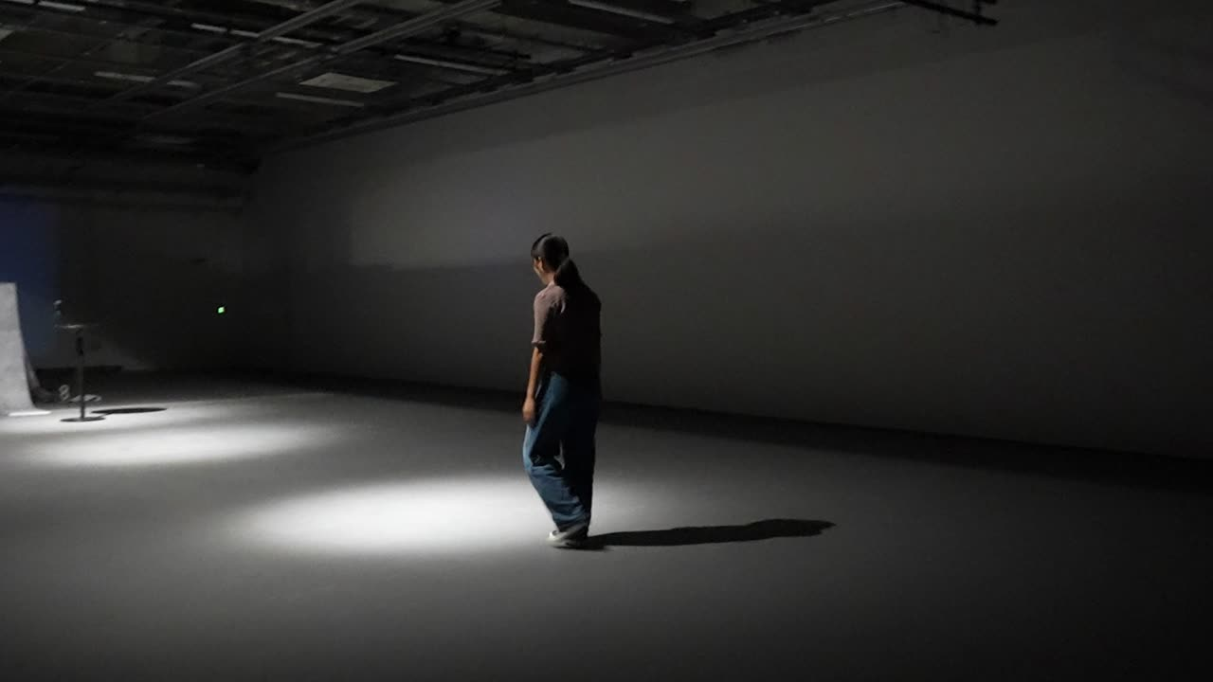
HARPY/ Codesign with the machine / 2026
FINAL PROTOTYPE

Slide 11
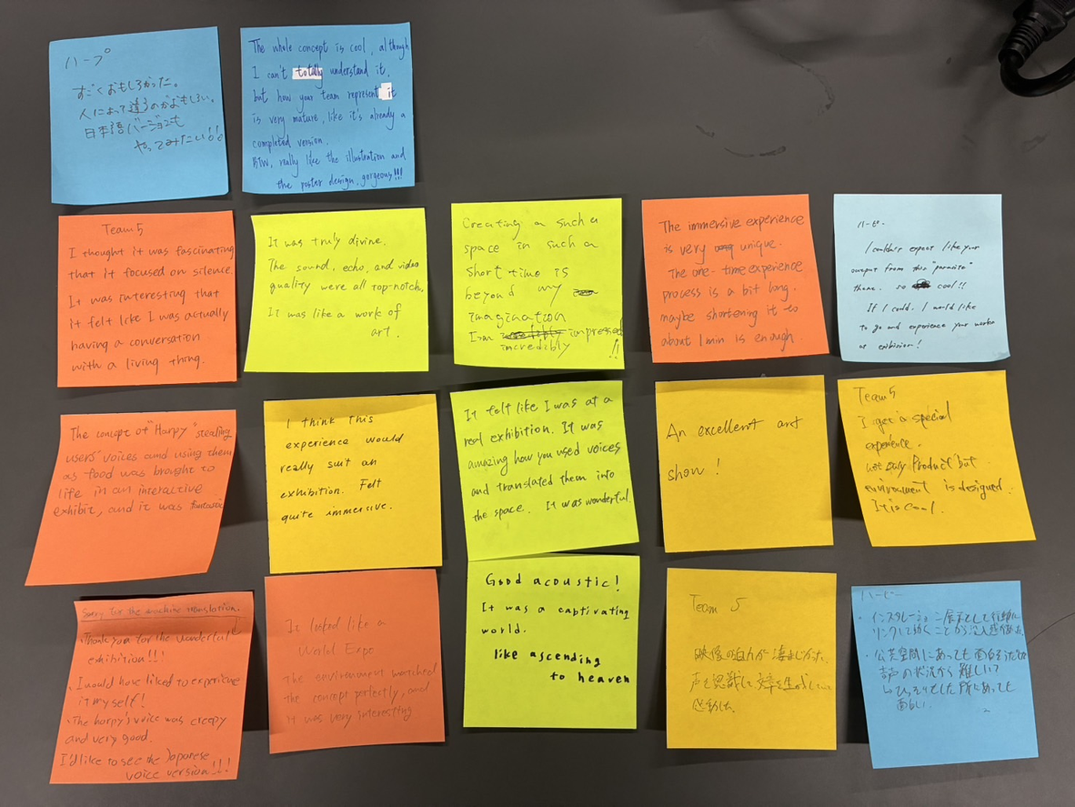
HARPY/ Codesign with the machine / 2026
AUDIENCE FEEDBACK

